Slide 1

PIPER: Primordial Inflation Polarization Explorer
Jeffrey Hatef
Mentor: Dr. Alan Kogut

Slide 2
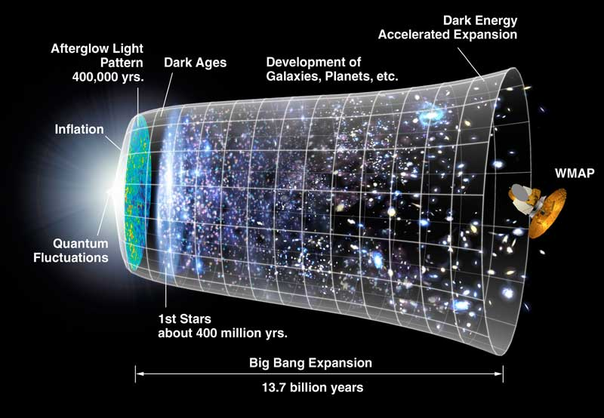
Inflation Theory: How is the Universe so big?
The universe appears too big, inflation is a possible answer.

Slide 3
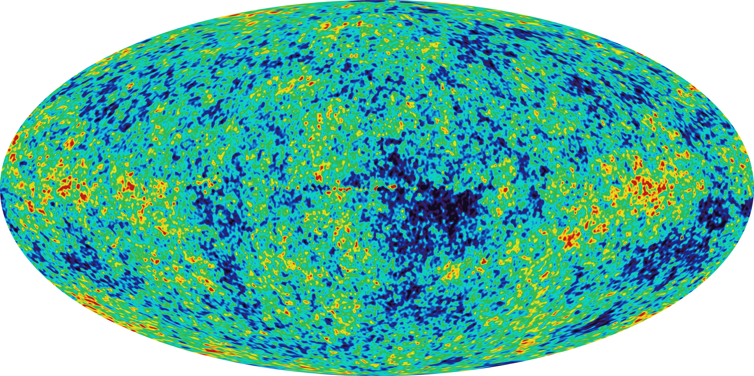
COBE and WMAP
COBE beginning in 1989 and WMAP in 2001 have mapped the sky in the microwave range.

Slide 4
PIPER: The next step
Current theory requires polarizations in the B mode caused by gravity waves rippling through the infant universe.
These minute polarizations are known to be in the nanoKelvin range.
PIPER will have the optics to record these polarization.

Slide 5
Detectors
The bulk of the work this summer has been on detectors.
Superconducting materials needed to be tested for use in Backshort-under-grid (BUG) array, Superconducting quantum interference device (SQUID), bolometers.
Thermistors will be used to measure RF radiation.

Slide 6

Bolometer Basics

Slide 7
The Work
Soldering cables, connectors and circuit-boards for the re-wiring of our cryo Dewar, SHINY.
We performed polarimetry experiments to show that a Winston collector did not interfere with the polarization of incident light.

Slide 8
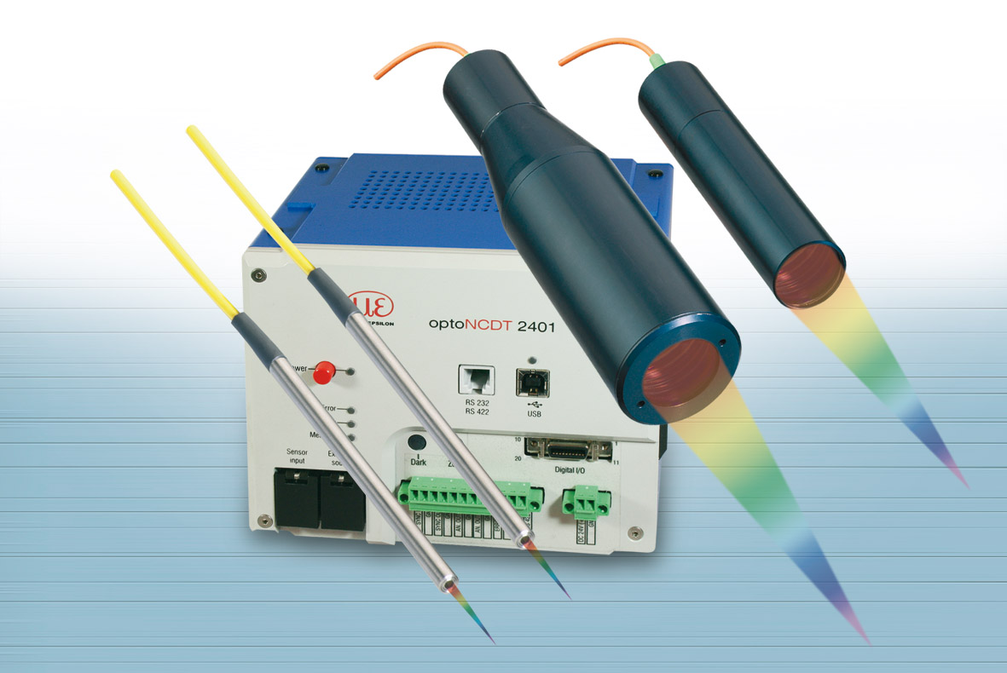
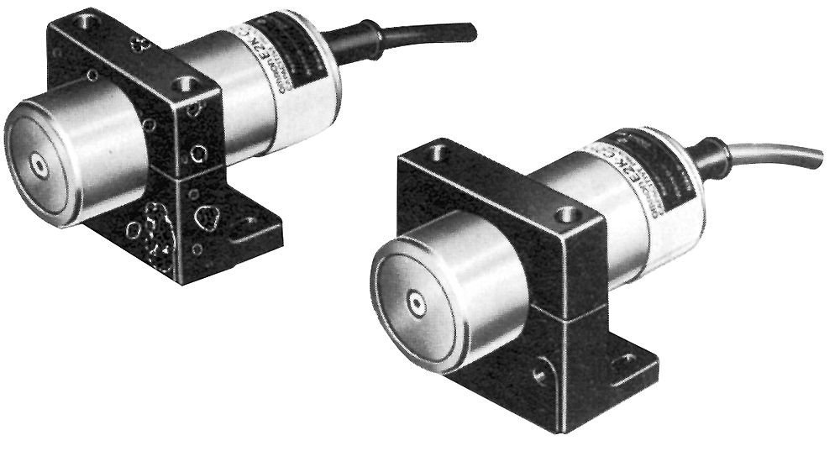
My Experiment
I checked the accuracy of capacitive distance measuring devices compared to the chromatic confocal spectrometer.

Slide 9
My Results
All capacitave sensors were extremely well standardized – to micrometer levels.
Some offsets were recorded that may be used in future flight missions!

Slide 10
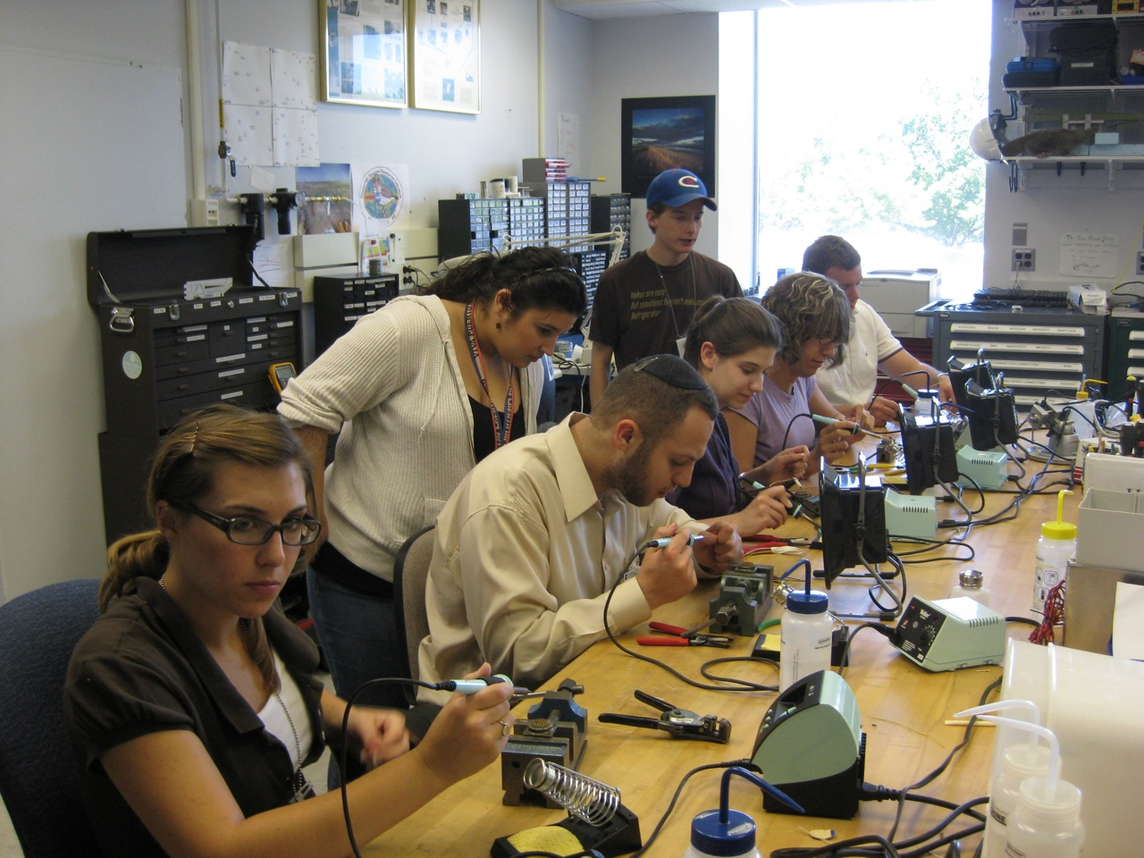
Thanks!
Alan Kogut and Paul Mirel
Luke Lowe, Amy Weston, and Sam Rodriguez
My fellow interns: Bailey, Joseph, and Alyssa

